Slide 1

GLOBAL TERROR ATTACKS
Research Question:
Discover what trends in the data there are and what it can tell us about global terrorism attacks in terms of where the hot zones are, the types of terrorist attacks, who the terrorist targets are, and who the largest terrorist groups are.
Data Source:
Data from this analysis was obtained from the GTD(Global Terrorism Database) at:
https://www.start.umd.edu/gtd/

Slide 2
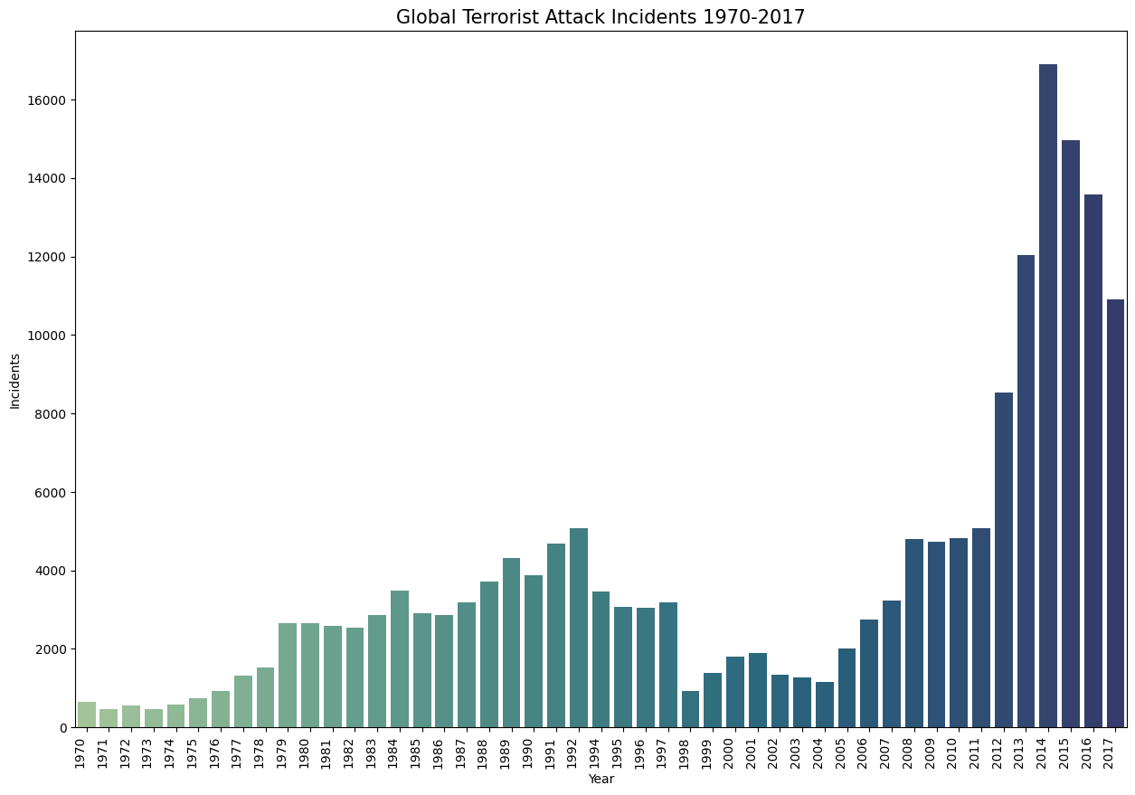
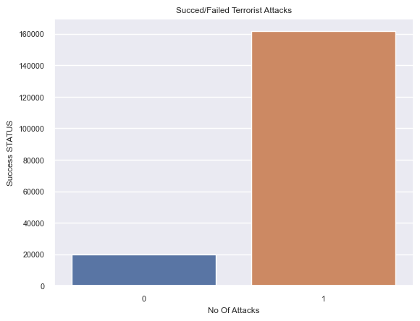

Slide 3
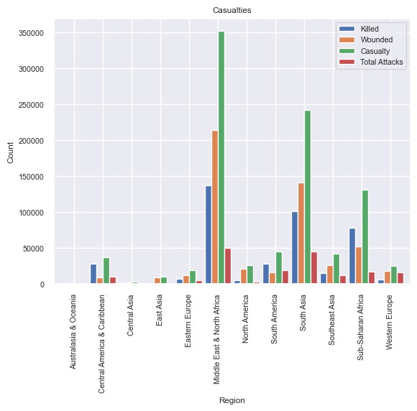
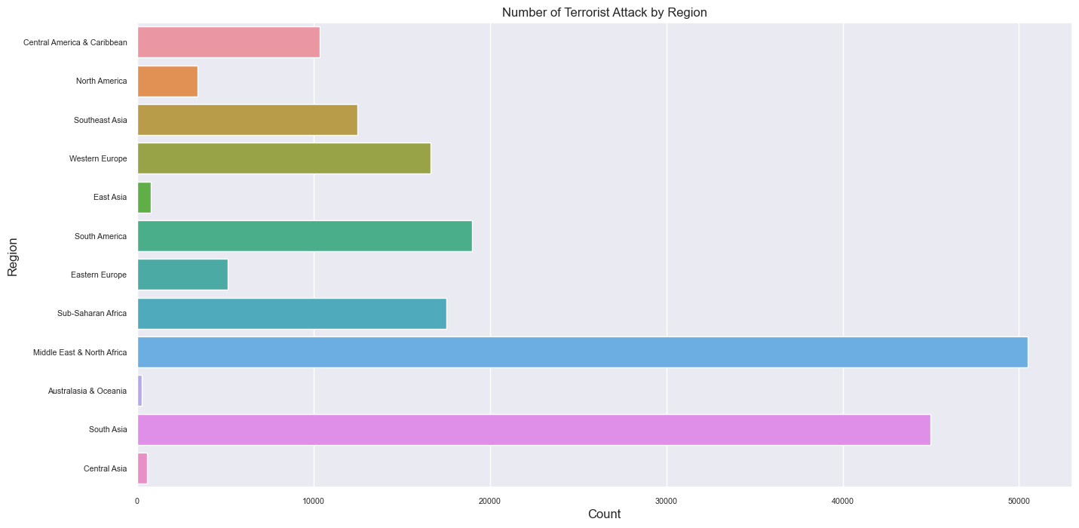
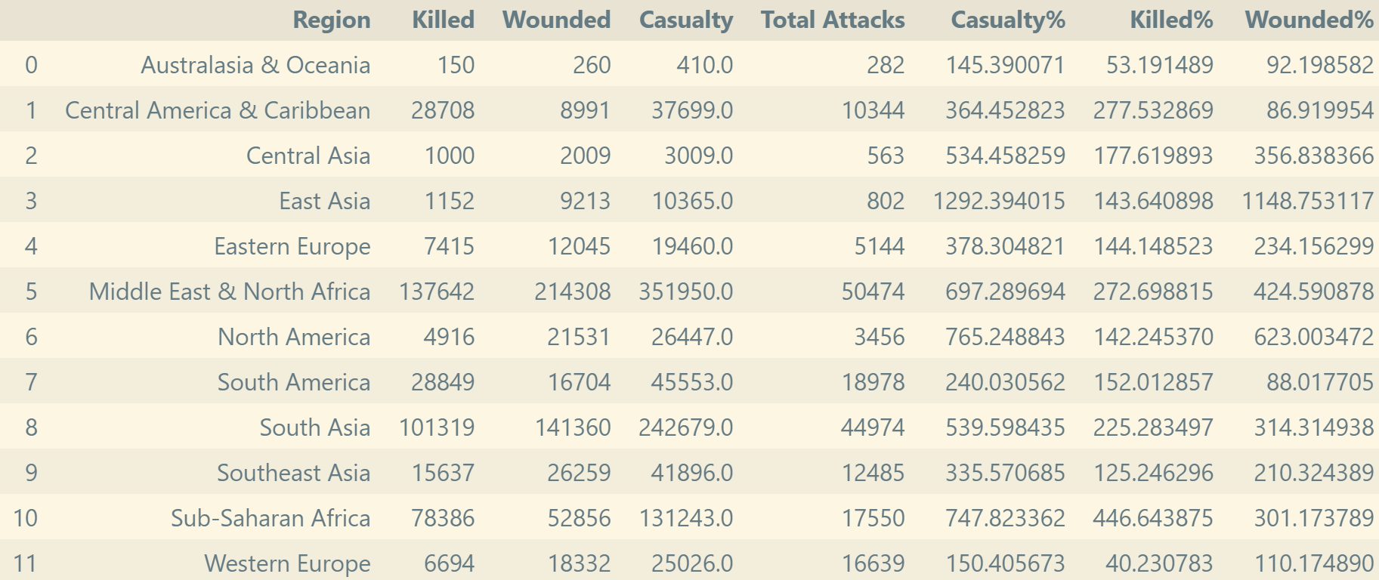

Slide 4
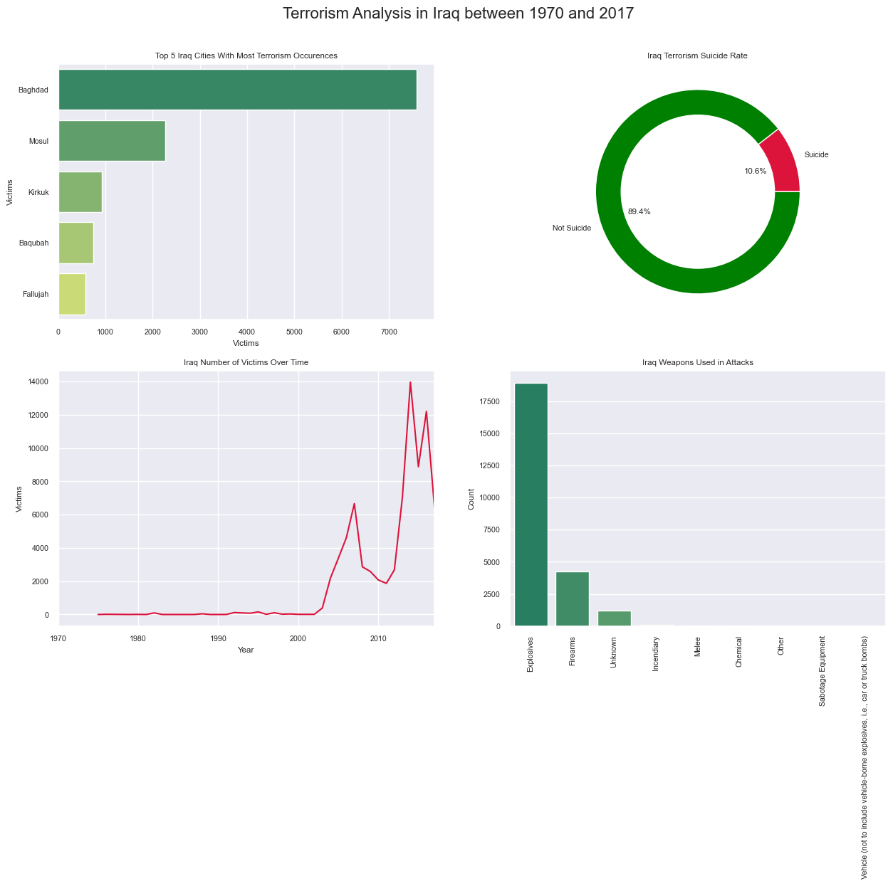
Year With The Most Attacks: 2014
Most Common Motive: The specific motive is unknown; however, sources suspected that the attack, which targeted members of the Sunni community, may have been part of a larger trend of sectarian violence between Iraq's minority Sunni and majority Shiite communities.
Average Property Damage: Minor: Likely Less than $1 Million
Most Common Attack Type: Bombing/Explosion
Most Common Weapon Type: Explosives
Most Common Target Type: Private Citizens & Property
Terrorist Group with Highest Number Of Terror Attacks: Islamic State of Iraq and the Levant (ISIL)

Slide 5
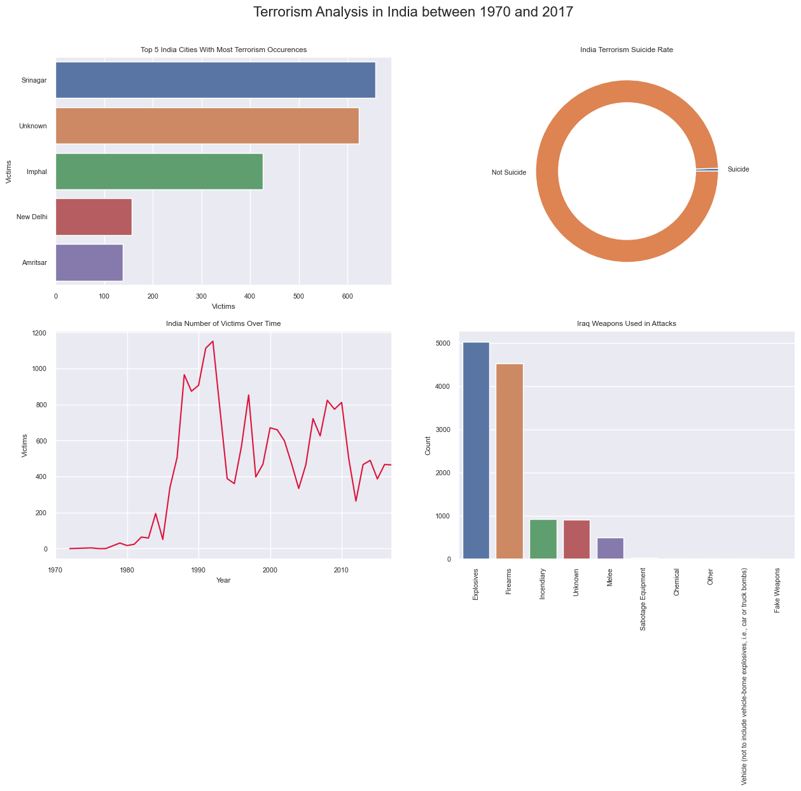
Year With The Most Attacks: 2016
Most Common Motive: The attack was carried out because the victim was accused of being a police informer.
Average Property Damage: Minor: Likely Less than $1 Million
Most Common Attack Type: Bombing/Explosion
Most Common Weapon Type: Explosives
Most Common Target Type: Private Citizens & Property
Terrorist Group with Highest Number Of Terror Attacks: Communist Party of India - Maoist (CPI-Maoist)

Slide 6
Findings
- Attacks were more during 2014 and then in 2015. When compared to attacks from 1970 onwards, the last 6 years scored a maximum. But from 2014 onwards count started decreasing.
- 89% of terrorist attacks are successfully attempted
- Iraq dominates all the countries and it has the highest number of attacks and then Pakistan, Afghanistan, and India follow it.
- Middle East and North Africa and South Asia are the two regions who encountered the most number of terror attacks since 1970.
- For most of the attacks, The target is Private Citizens & property and the next is on Military leads.
- Most of the attacks were through either Bombing or Explosion.
- 'Islamic State of Iraq & the Levant (ISIL)' and 'Taliban' are two most active Terorrist groups in the last 5 years.
- Srinagar and Bhagdad are the most attacked cities
- Private citizens and property are the most commonly affected by terroristic activity

